Slide 1
LDF x HDAG Final Presentation
Monday, December 18, 2023
Henry Wu, Amy Feng, Chris Ferreira, Cathy Hou, Sabrina Hu,
Lucy Jiao, Mohammad Khan, Max Peng

Slide 2

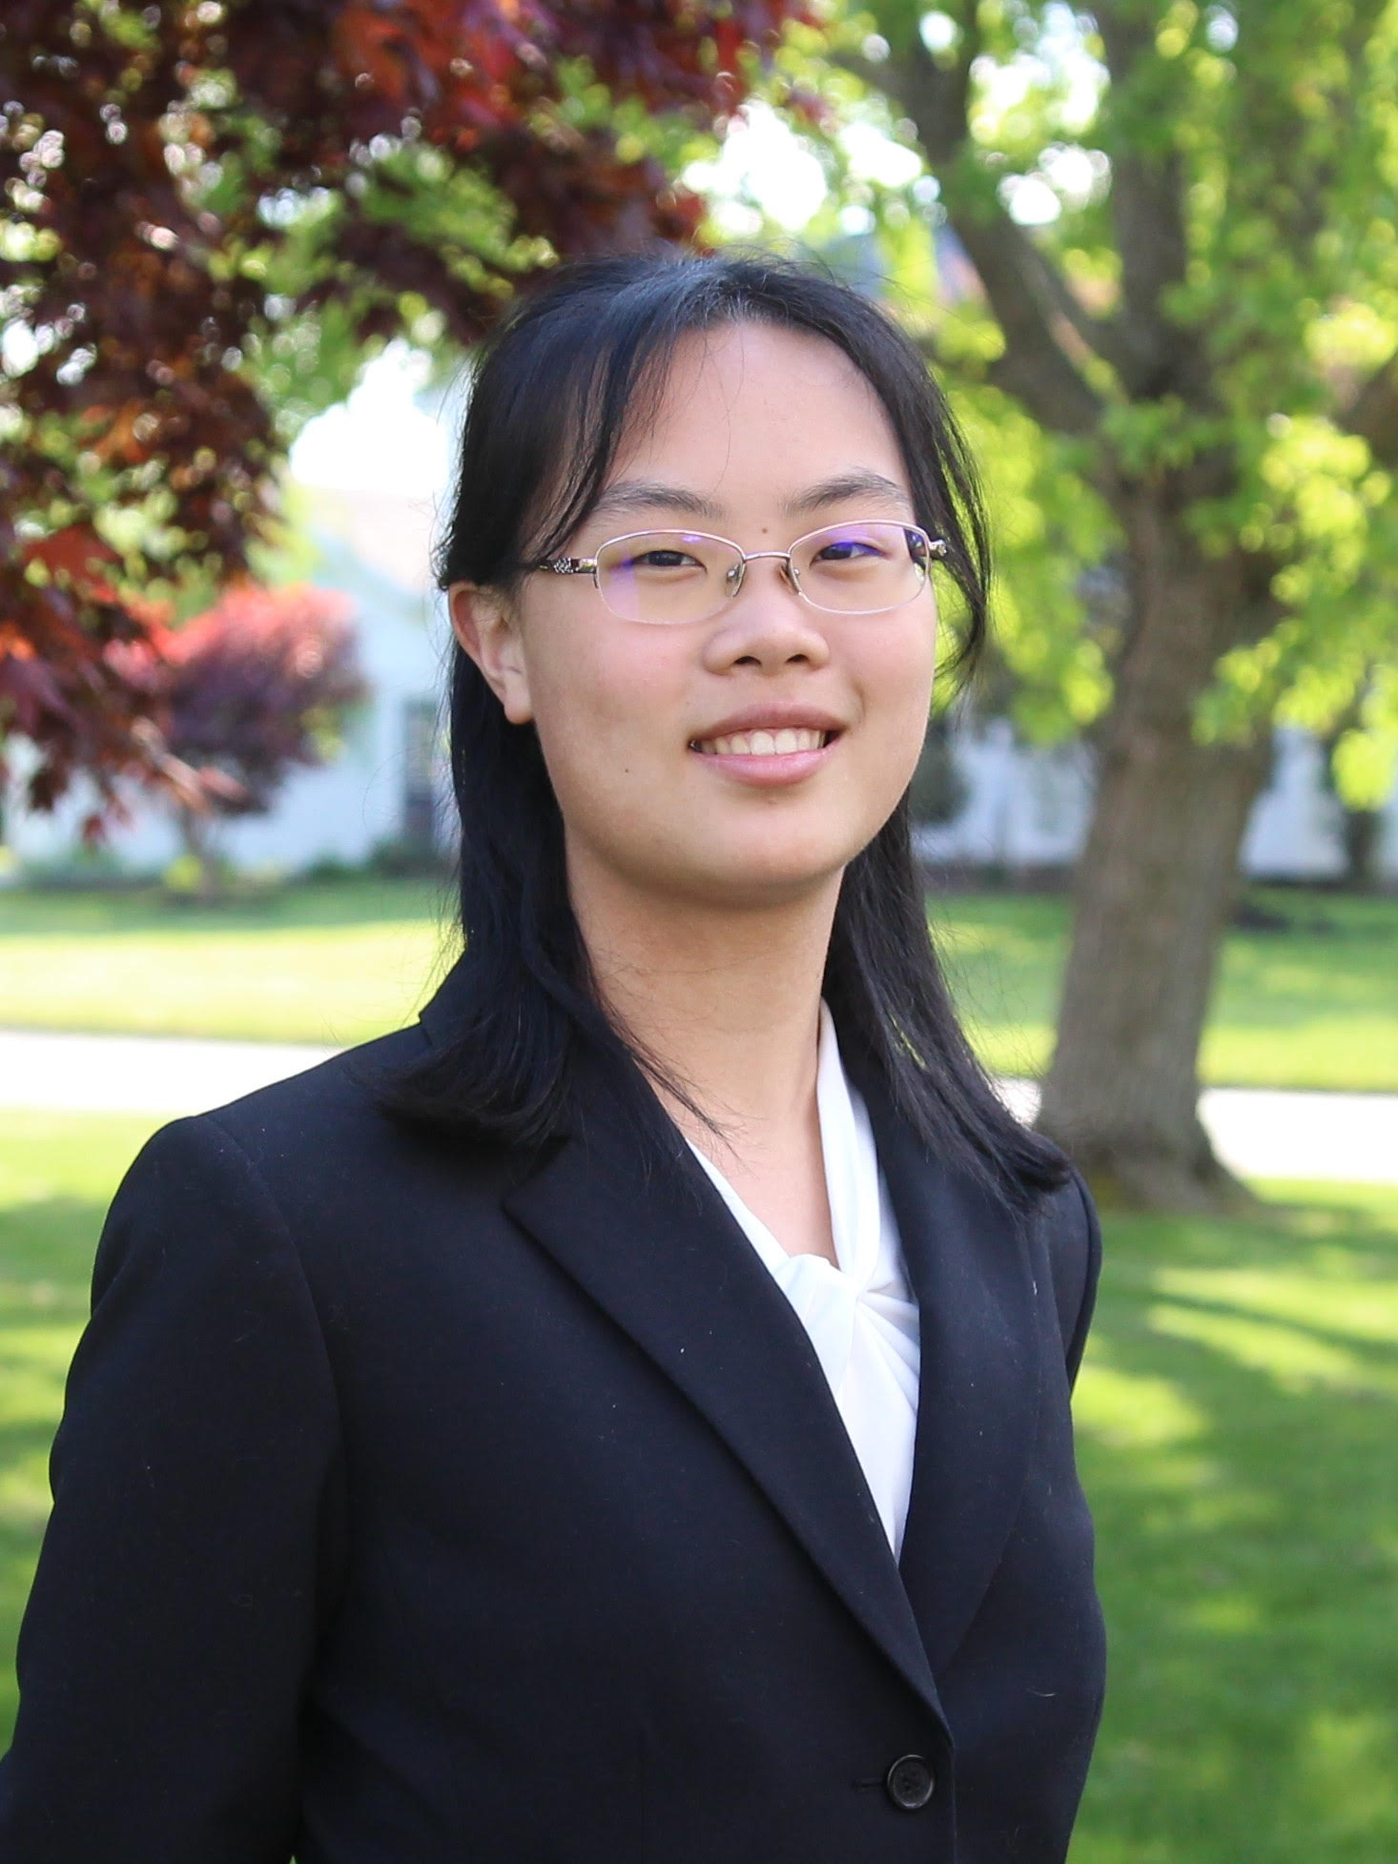



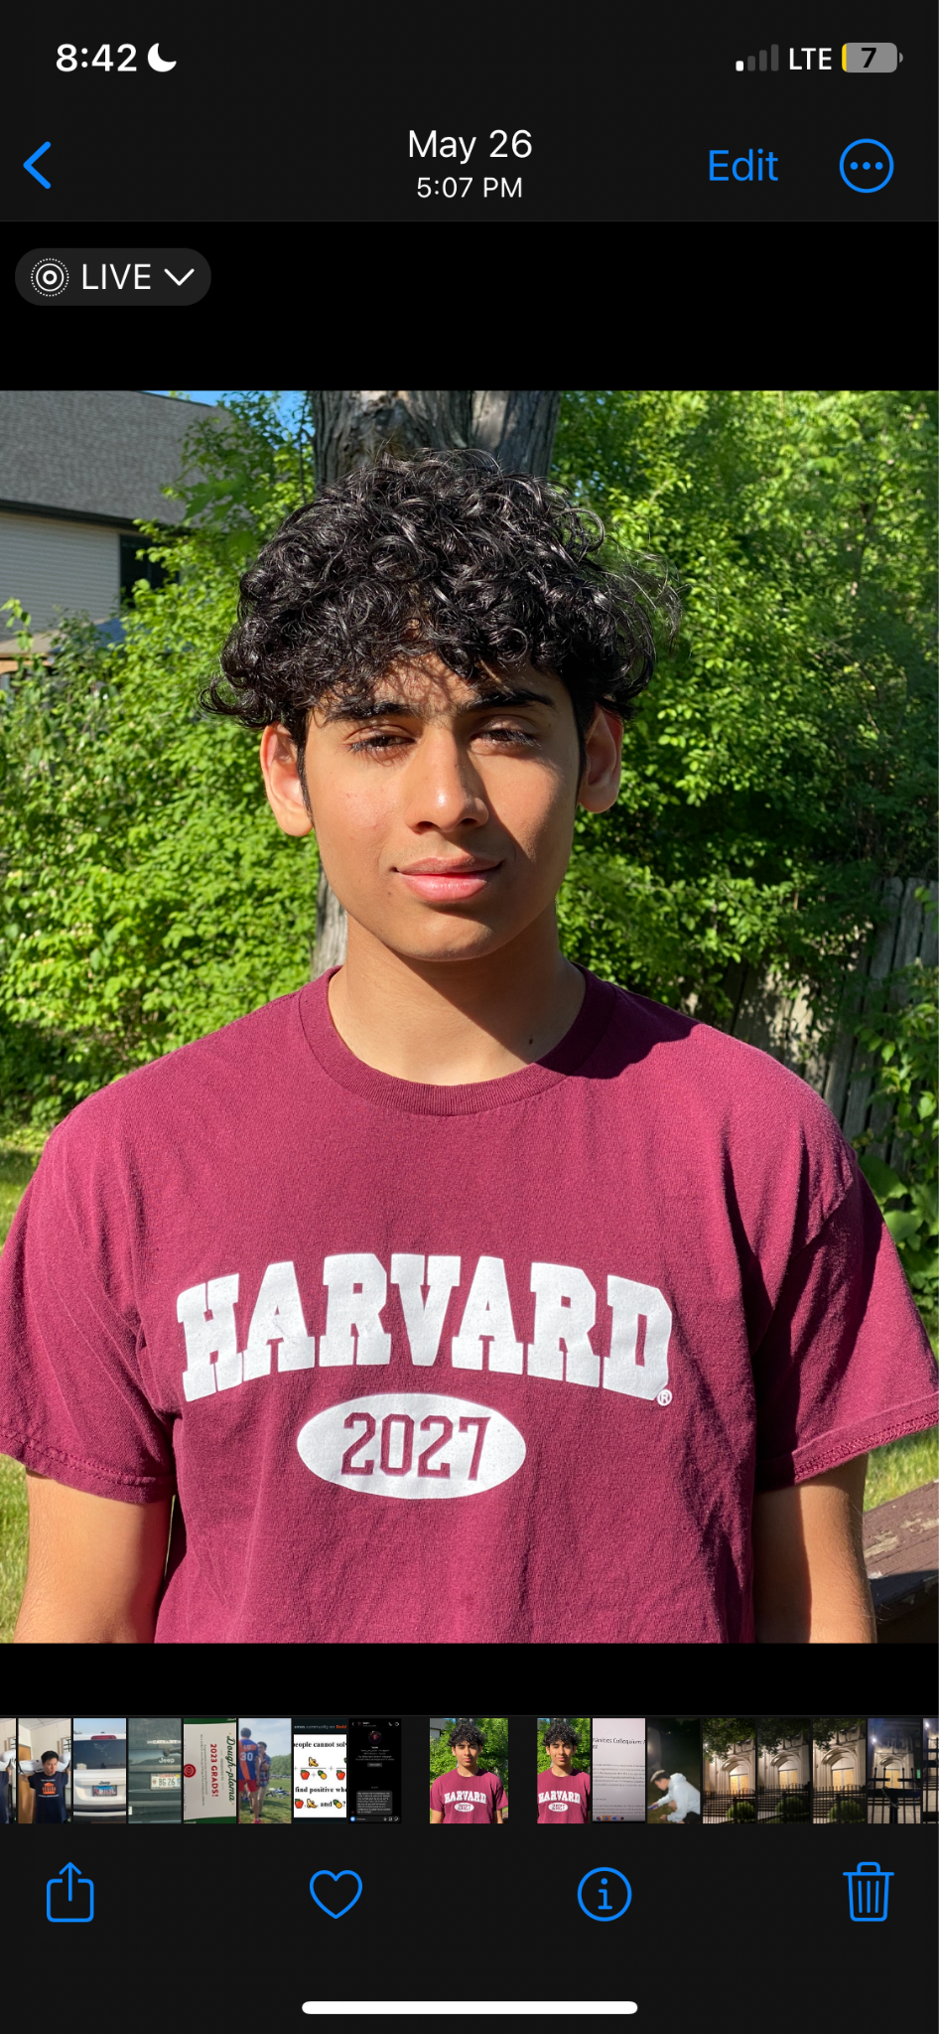
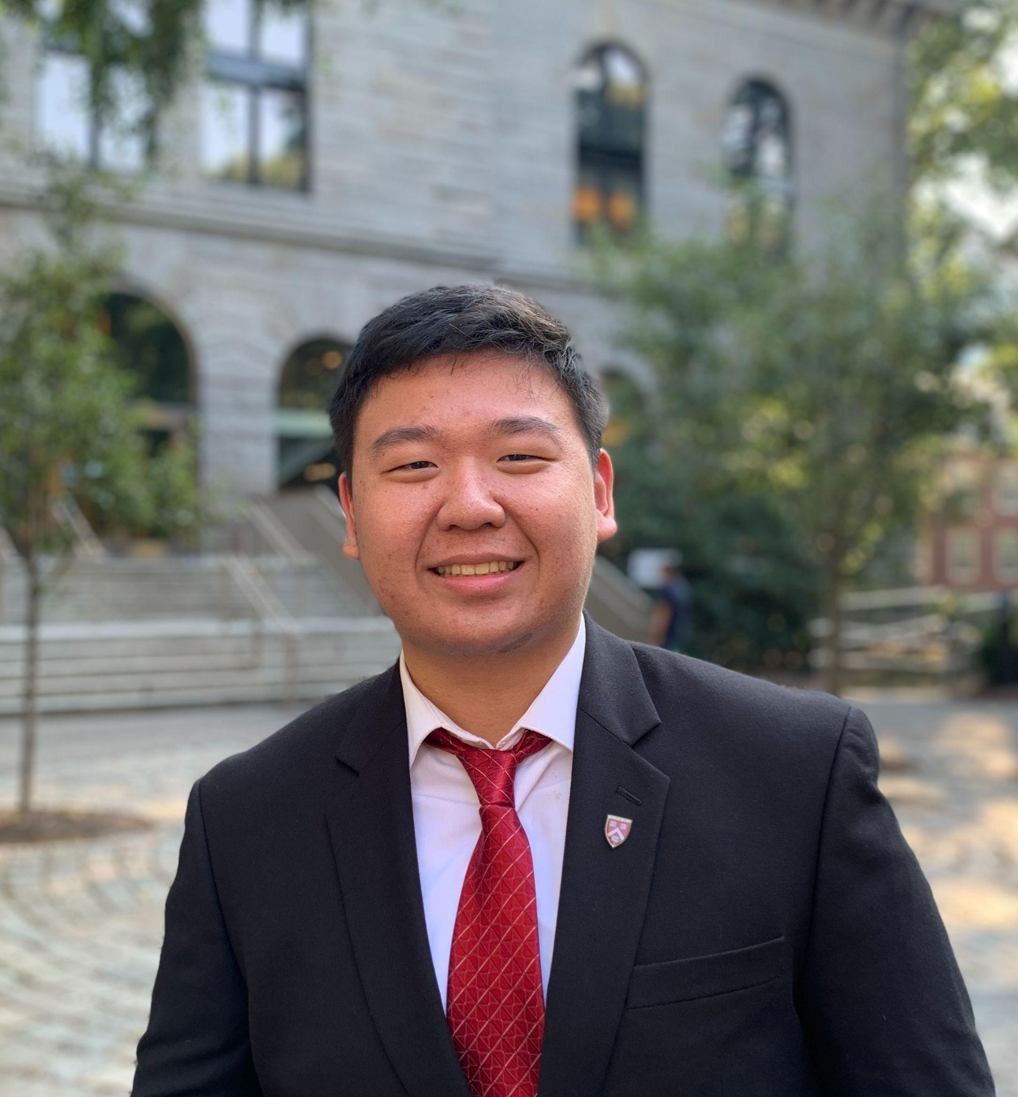
Henry Wu
Amy Feng
Chris Ferreira
Cathy Hou
Case Team Lead
Associate
Analyst
Analyst
Sabrina Hu
Lucy Jiao
Mohammad Khan
Max Peng
Analyst
Analyst
Analyst
Analyst

Slide 3
Project Overview
Overview of project timeline and objectives.
Midpoint Review
Brief review of our progress as of mid-November (misinformation classification and topic detection models).
Data Automation and Model Evaluation
Description of automated news article retrieval and evaluation of models on new data.
Conclusion and Q&A
Discussion of challenges and next steps, questions, and feedback exchange.

Slide 4
Timeline, Objectives, and Resources
Project Overview

Slide 5
Project Timeline
Final Presentation
We compiled data sources to train misinformation classification and topic detection models.
We automated the retrieval of news articles to generate new data for model training and evaluation.
Model Building
Data Automation
Onboarding
Midpoint Presentation
Final Presentation
In late September, we convened as a case team and began background research.
In mid-November, we presented preliminary work on misinformation models and theorized about topic detection models.
Today, we will share our final deliverables, conclusions, and recommendations for future work.

Slide 6
Project Objectives
Voting Issue Detection
Help ensure election integrity by monitoring reports of election-related issues and sorting claims into topic categories
Misinformation Detection
Voting Issue Detection
Detect false or misleading information about elections that could impact people’s ability to vote
Misinformation Detection
Data Automation
Data Automation
Enable the above two models to take in streams of new data (preferably in real-time)
Report Generation
Report Generation
Summarize the findings of the above two models in reports easily understood by LDF staff and/or volunteers

Slide 7
Summary of Prior Work
Midpoint Review

Slide 8
Midpoint Review
Data Processing - Extracting text from URL links in client-provided monitoring dataset
Challenges:
We continued to have trouble scraping twitter Data.
Failed approaches:
Twint - unrecognized dependencies
Snscrape - Tweet object parameters
GetOldTweets3 - Requires username
Next steps:
Selenium - scrapes dynamic websites by stimulating a browser environment
There is an existing Python project that aims to do this - twitter-scraper-without-api.
Misinformation Classification
DistilBERT is lightweight language model with potential to efficiently and accurately perform the misinformation classification task
Transfer learning is useful to prevent starting from scratch, allowing for faster training times
~90% accuracy in our own implementation
Requires labeled data

Slide 9
Midpoint Review (cont.)
Topic Detection
LDA: Unsupervised learning
Randomly try to find similar words to cluster together “topics”
No manual intervention needed to label the data
Number of topics is customizable, so topics can be coarse or fine
Manually needs to assign human readable “topics” given which words are associated
Topic Detection
BERTopic: Unsupervised learning
Create clusters for easily interpretable topics with important words in cluster descriptions
Can categorize type of issue/misinformation in text data
Has supervised variants that may be more helpful for training for a specific context

Slide 10
Automated Retrieval of News Articles
Data Automation

Slide 11
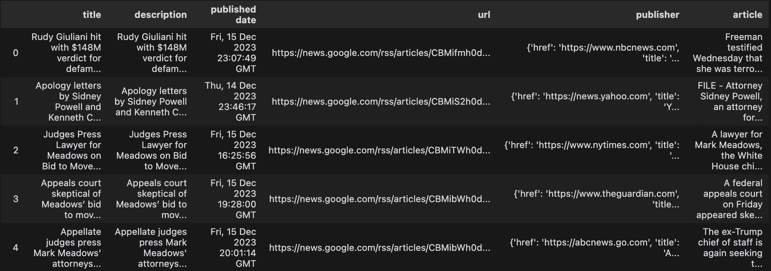
Google News API provides an automated way to fetch news articles
Google News extraction script
Input: keywords related to elections or voting
Use gnews API to extract article data & text
Output: csv file with keyword-related data
Title, description, published date, url, publisher, article
Other API functionality not incorporated in script yet
Get news by location, news site
Results specifications (country, language, start date/end date)
Article properties (author, images)

Slide 12
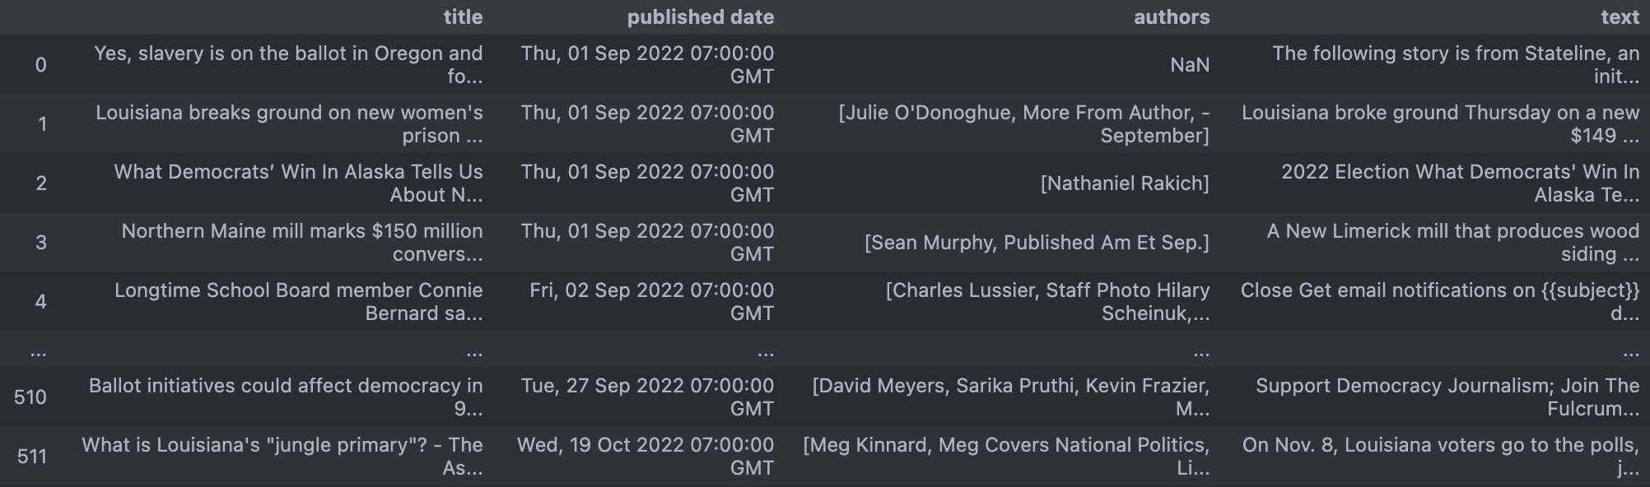
Secondary training dataset: “Louisiana election”, 9/1/22 – 11/8/22
Constructed by searching for “Louisiana election” in 1-day increments from September 1 to November 8, 2022, retrieving up to 100 results per day
515 articles retrieved
Some not relevant to elections
Some text extraction unsuccessful due to paywalls and HTTP request errors

Slide 13
Model Evaluation

Slide 14
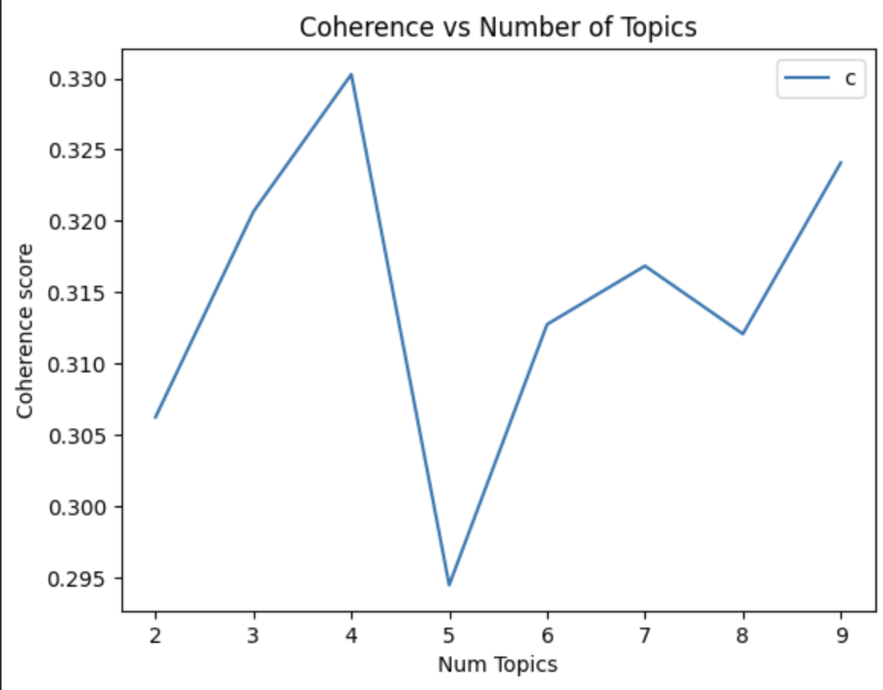
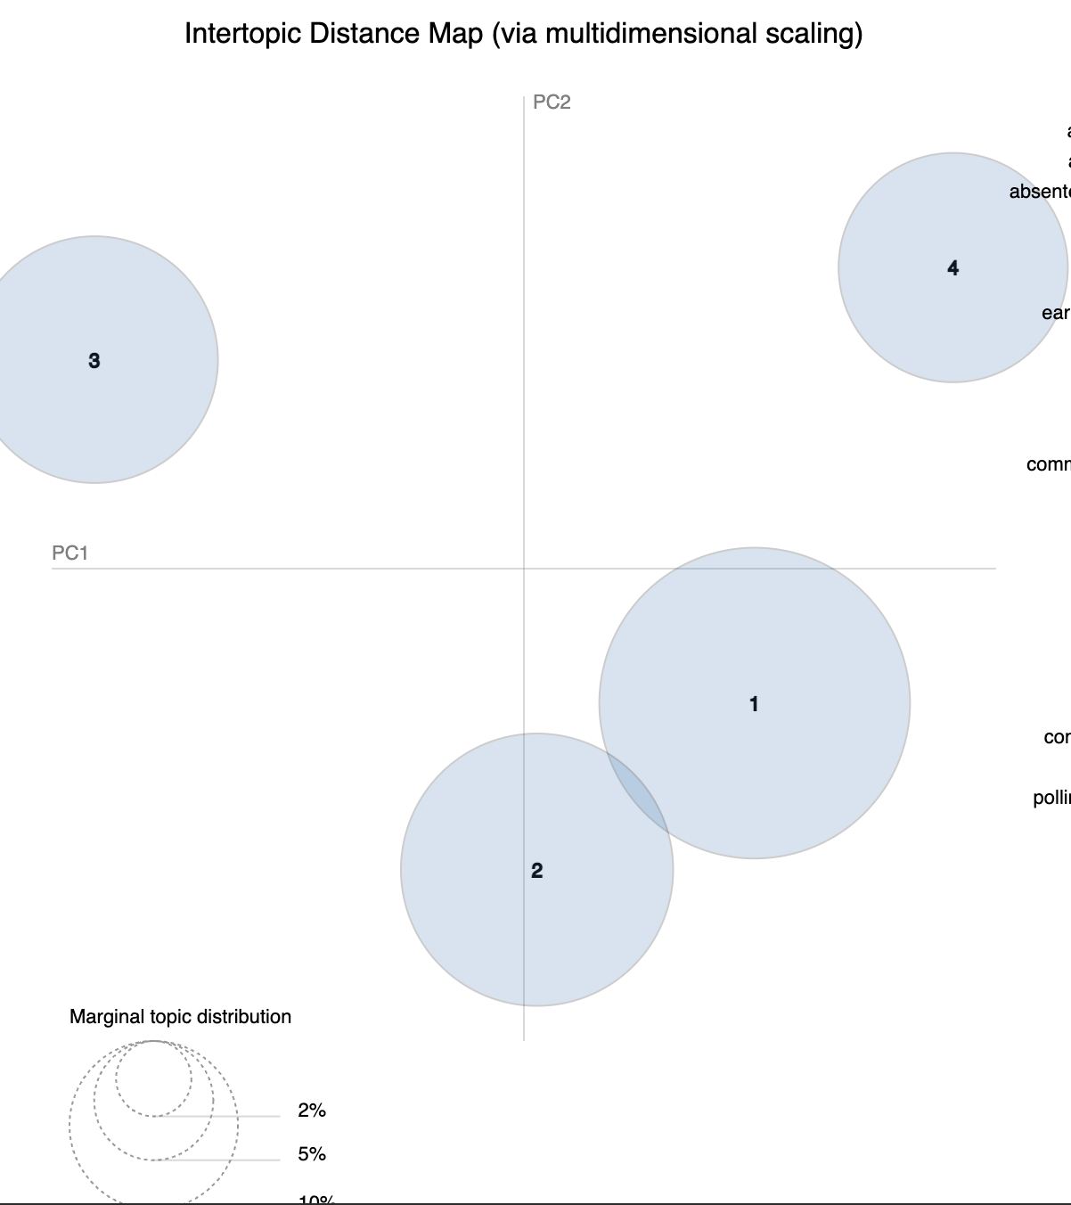
LDA on Statewide Reports Dataset
Still need to infer topics manually
“Early”, “ballot” → early voting
Some topics overlap and are hard to tell apart
Hyperparameter (Number of topics) found to be around 4
Coherence is how similar the words are within a “topic”
“Here you can find answers to your questions about topics such as eligibility for an absentee ballot…” → topics: absentee ballots (probability: 1.0)

Slide 15
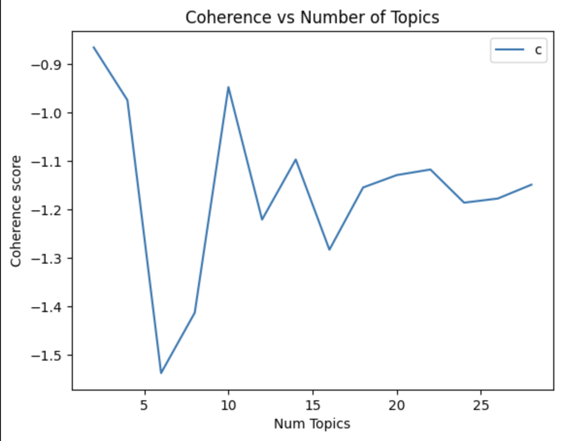
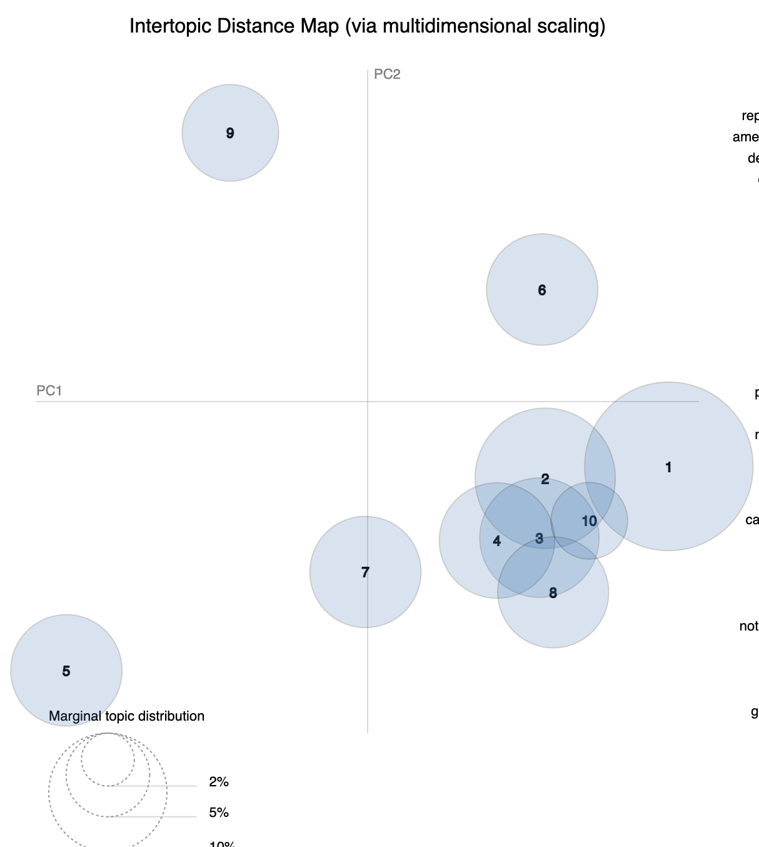
LDA on Louisiana Google Search Results
Found that 10 topics works decently well
A lot of topics seem to overlap, but do have distinct words that stand out in most topics
I.e. “attorney_general”, “amendment”
Test tweet:
"15 minutes left to vote for @JohnBelforLA and Democrats down the ballot, Louisiana! If you're in line when polls close – STAY in line. You're legally allowed to vote. Confirm your polling location at http://IWillVote.com." – @LaDemos
topics: governor election (probability: 0.62), election day (probability: 0.35)

Slide 16
Future steps for LDA
The dataset is likely too small currently to have very accurate results on unknown data
LDA Mallet is also known to improve performance, but was not able to be implemented this time
More hyperparameter search may be helpful to find the best ones
Averaging models and coherence may be more helpful to determine hyperparameters
This may take a lot of computational time
Note: Potential Con
LDA is a Random model, so retraining could generate completely different topics (need to save model for future use)

Slide 17
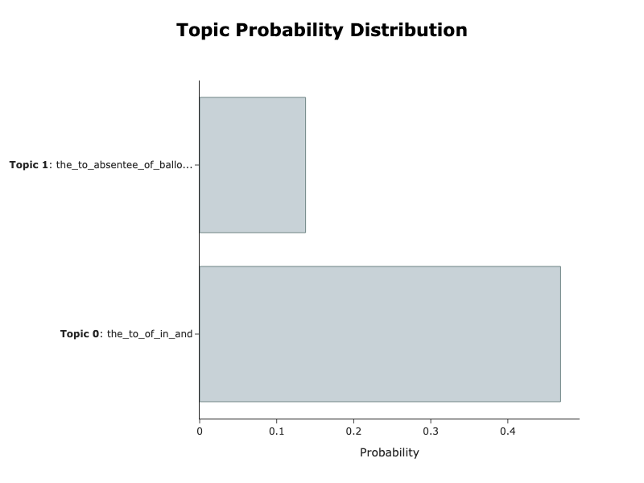
BERTopic on Statewide Reports Dataset
After filtering through empty cells and finding usable data, we found that we had an extremely limited number of actual articles (~50)
Elected to run BERTopic unsupervised
Didn’t have enough articles per intended topic to run supervised
Results were still suboptimal; BERTopic only found two topics
Absentee ballots: legitimate category, demonstrates promise
Filler/”stop” words: the, to, of, in, and
Next Steps: scraping, retraining, parameter optimization

Slide 18
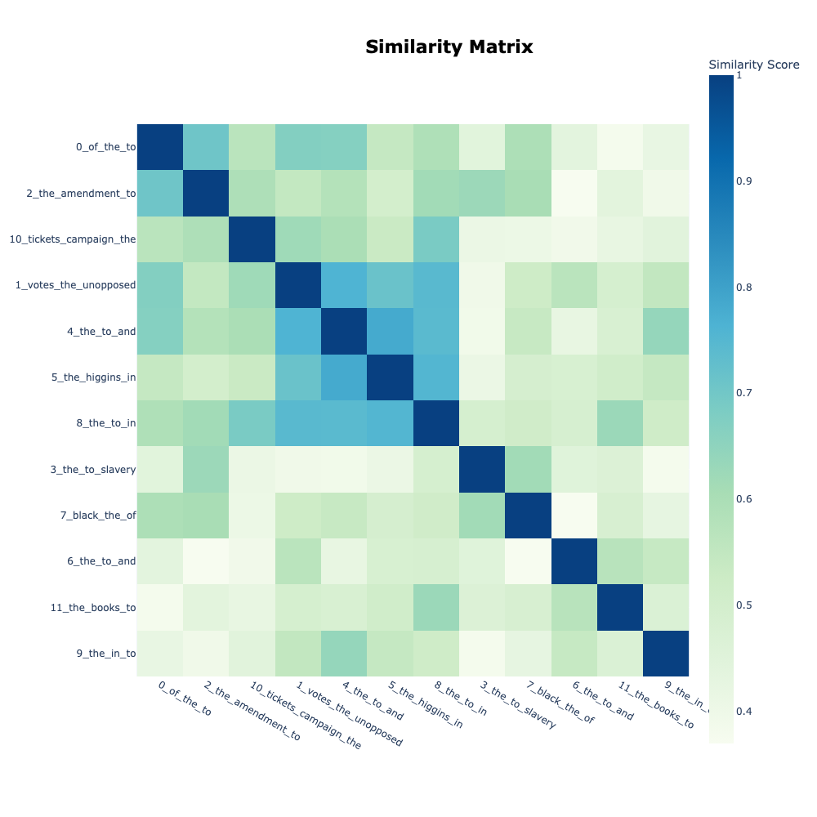
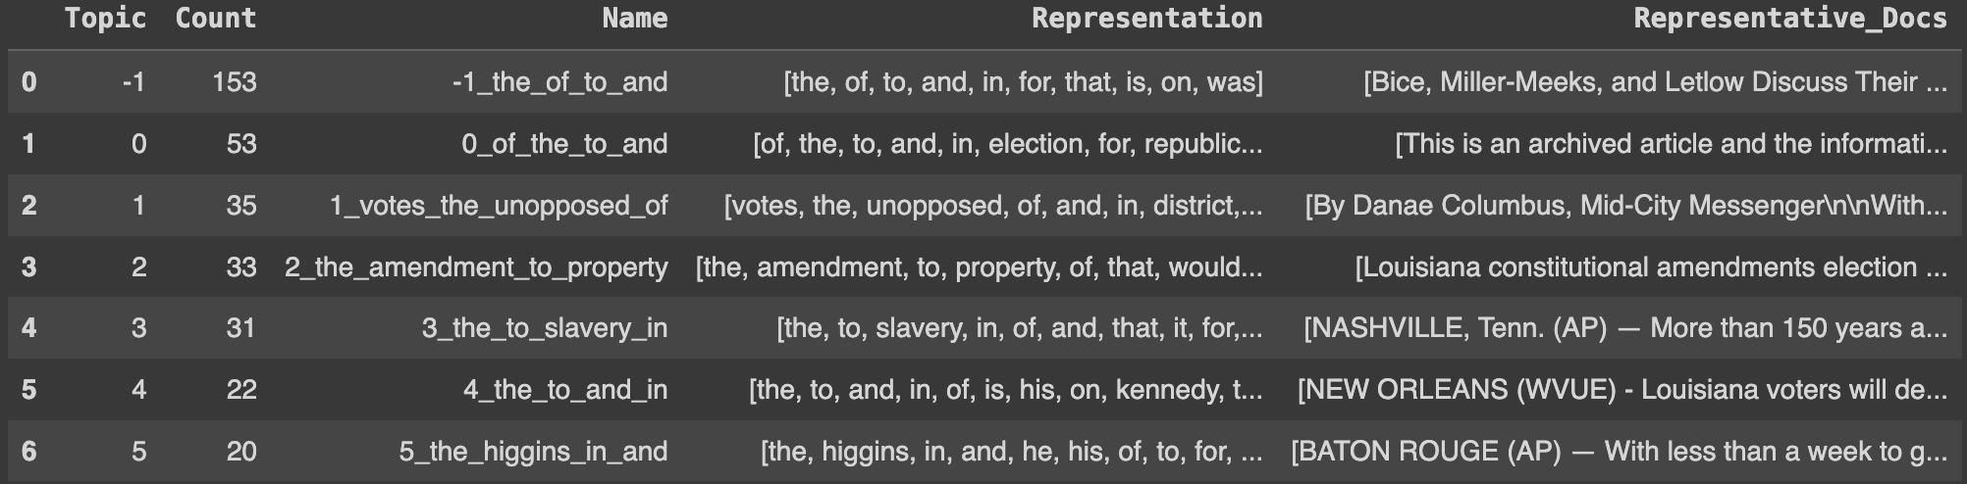
BERTopic on Louisiana Google Search Results
Due to the lack of usable data, we decided to retrain BERTopic on the dataset of Louisiana Google Search Results
Achieved better results with more varied topics, but still had some topics comprised of mostly filler and stop words
Next Steps: Look into alternative encoders (that eliminate stop words)

Slide 19
Next Steps, Questions, and Feedback
Conclusion

Slide 20
Challenges, Next Steps, and Recommendations
Misinformation Classification
The DistilBERT model for misinformation detection requires labeled data for training, which can be hard to come across
Use LDF 2020 Remote Monitoring Dataset tags (misinformation or otherwise)
Periodically manually tag a subset of data as it comes in
LDA seems to find different numbers of topics on different datasets - may be issues integrating multiple datasets
The truth of a claim may depend on temporal/geographic context
Knowledge base approach
BERTopic
Introduce method to classify text with multiple categories of misinformation
Consider different topic modeling techniques that still use BERTopic
In particular, supervised, semi-supervised, and guided techniques can use predefined election related words to “nudge” topic creation
Best to start implementing a BERTopic model after a sizeable dataset is obtained

Slide 21
Challenges, Next Steps, and Recommendations (cont.)
Data Automation
Automated retrieval of Tweets is expensive
Wait for workarounds such as twscrape (JavaScript) to be developed
Try an automation suite such as Selenium
Google News API has unexplored functionality
Combine location and keyword searches
Search certain websites
Increase maximum number of results returned beyond 100
Report Generation
Unexplored area of work
Leave outputs of models as-is to reproduce the tabular format of the volunteer monitoring dataset
Use generative AI to create reports that summarize the insights from the models
Analysis of results is effectively a separate challenge (e.g. detecting trends in voting rights issues)

Slide 23
Appendix A: Resources
Data
LDF 2020 Remote Monitoring Dataset
Client-provided dataset of volunteer form submissions for voting-related issues
Social media posts, news articles, and government election sites
Politifact/Snopes
Claims from fact-checking websites sorted into “true” and “false” claims
Politifact deals with US political figures and Snopes more general claims
Kaggle Fake and Real News Dataset
Dataset on a variety of politics-related news from 2019 and previous years
Other Materials
Examples of accurate election dates/deadlines and info (Louisiana)
Could potentially be used as a knowledge base for misinformation claims
LDF Remote Monitoring Form
Current version of the form submitted by volunteers to report voting-related issues
LDF Volunteer Monitoring Toolkits
Guide for volunteers to search for election issues to report
Broken down by key states (AL, FL, GA, LA, MS, SC, TX)

Slide 24
Appendix B: Further Exploration
Data/Models/Software
Using NLP for Fact Checking: A Survey
Fake News Challenge
MisInfo Text
twscrape (JavaScript Twitter scraper)
Selenium (automation suite)
Artificial Intelligence and Elections
CLC’s Trevor Potter Testifies at Senate Hearing on AI in Elections | Campaign Legal Center
How AI Puts Elections at Risk — And the Needed Safeguards | Brennan Center for Justice
Artificial Intelligence and Election Security | Brennan Center for Justice

Slide 25
Andrew Li, andrewli@college.harvard.edu
Henry Wu, hhwu@college.harvard.edu

